Slide 1
OOP and UML Fundamentals C++ OOP Aspects
Fundamental OOP Concepts. UML Class Diagrams

Slide 2
Programming Paradigms
How do you approach a problem?
Notes:
The way we approach the problem
The way we model the problem
The primitives of the design

Slide 3

Programming Paradigms Imperative Programming – Introduction
“In computer science terminologies, imperative programming is a programming paradigm that describes computation in terms of statements that change a program state.”
“Do this – do that” approach

Slide 4
Programming Paradigms Imperative Programming – contd.
A problem is approached using “step-by-step” modeling: break down the functionality into series of steps
Best in products where sequence of steps is fixed or rarely changed
Finer-level steps can be combined into larger blocks (procedures) to produce clear, concise and manageable sequence at each level
Start
First time on?
Load calibration data
Calibrate
Store calibration data
Detect position
Target reached?
Calculate movement vector
Apply movement

Slide 5
Programming Paradigms Imperative Programming – Procedural
Focus on procedures – a series of instructions that can be called from any point in the program
In C/C++ - "functions"
Procedures help achieve some degree of modularity
Modularity allows for testability, reusability, maintainability, …

Slide 6
Programming Paradigms Imperative Programming – Pros & Cons
Pros
Matches the underlying technology
Easy to create or comprehend, especially for small systems
Easy to derive directly from user requirements
(? pro/con) Supported by modern object-oriented and (some) functional languages
Cons
No direct way to communicate the relation (and consistency) between data and procedures/functions
Basic reusability unit is function which is not very stable and is prone to frequent changes for both requirement and technical reasons
Does not reflect correctly the real world, which is made of interacting entities, not separate activities and data

Slide 7
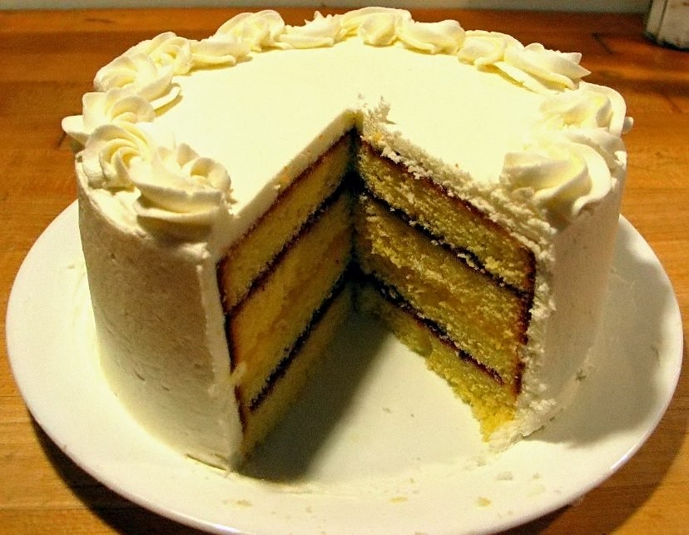
Programming Paradigms Declarative Programming
Unofficially: "Style of programming that is not imperative"
“In computer science, declarative programming is a programming paradigm, a style of building the structure and elements of computer programs, that expresses the logic of a computation without describing its control flow.” - Wikipedia
“A program that describes what computation should be performed and not how to compute it”

Slide 8
Programming Paradigms Declarative Programming – Examples
SQL Example
SELECT *
FROM Students
WHERE age > 35
ORDER BY name
Linq
Functional programming

Slide 9

Programming Paradigms Object-Oriented Programming – Intro
Where does it stand? Is it Imperative, or Declarative?
Based on the concept of objects which combine data and behavior
When solving a problem, the primary focus is on objects and their relations/interactions
Example: a Car has an Engine, Chassis, Wheels, … Then Engine itself has Cylinders, Sensors, etc.

Slide 10
Programming Paradigms Object-Oriented Programming – Pros & Cons
Pros
Closer to the real world – entities that we want to model are often directly object-oriented ready
The link between data and processing code is built into the syntax – the system is aware about it
Reusability units are much more obvious (often a class is directly reusable) and, with proper design, much more stable than functions
Cons
Requirements are not very object-oriented; from them, suitable objects / classes need to be extracted and defined by the software Designers / Architects
The underlying hardware, storage, communications, etc. operate as series of operations, i.e. closer to Imperative paradigm

Slide 11
Object-Oriented Programming Fundamentals
No objections

Slide 12
Object Oriented Programming Introduction
Completely different way to approach a problem
Start by describing objects, their relations and interactions
Key question to start in OOP way: "What are we talking about?" (instead of "what the program will do"!)
At the end, objects' behavior is still imperatively described (i.e. method implementations)
In short, objects combine data and behavior
A developer can think in object-oriented manner and still use "procedural" language such as C
However, in object-oriented languages there is suitable syntax to express the link between data and behavior of an object
This helps find errors, ease the process of development and developer testing, redesign and/or expand the system more safely, etc.

Slide 13
Object Oriented Programming Objects & Classes. UML Class diagrams
Objects can often be categorized into classes – groups of objects having the same general attributes and operations (behavior), but possibly differing in their values
Example of a simple UML class diagram (with just 1 class in it):
Class name – Cup. Example objects may be myCup, coffeeCup, … (not shown below). Choose class and object names carefully!
All Cup objects (instances) have the same set of attributes (color, capacity and quantity) but possibly different values (i.e. color=RED for myCup, vs. color = BLACK for coffeeCup). They also have the same operations.
Name
Attributes
Operations

Slide 14
Object Oriented Programming Objects & Classes – Access Modifiers
Access modifiers (in a class) specify from where is a certain member (attribute or operation) accessible.
In example, for an attribute the term "access" can mean read its value, write its value, get address of, etc. For an operation "access" usually means to execute the operaton (call the method), but might also mean get its address.
Strongest specifier is private: only code belonging to the class itself can access a private member. "Code" here roughly means functions / methods
Weakest specifier is public: all functions and methods can access a public member
There is a number of intermediate levels of access, in C++ only protected ()
private
protected
public

Slide 15
Object Oriented Programming Objects & Classes in C++
// cup.hpp
#ifndef CUP_HPP_
#define CUP_HPP_
class Cup {
public:
void fill(double quantity);
double getQuantity();
private:
double capacity;
double quantity;
};
#endif /* CUP_HPP_ */
Simplified
Real-world
// main.cpp
class Cup {
public:
void fill(double quantity) { // inline
this->quantity += quantity;
}
double getQuantity() { // inline
return quantity;
}
private:
double capacity;
double quantity;
};
File Structure!
// cup.cpp
#include "Cup.hpp"
void Cup::fill(double quantity) {
this->quantity += quantity;
}
double Cup::getQuantity() {
return quantity;
}

Slide 16

Object Oriented Programming C++ fundamentals. Default arguments. Overloading
Default arguments
void printCoordinates(double x, double y = 0.0, double z = 0.0) {
cout << x << ", " << y << ", " << z << endl;
}
printCoordinates() can be called with 1, 2 or 3 arguments
printCoordinates() is the same function / sequence of instructions taking 3 parameters, just they have default values sometimes
Function & operator overloading
int add(int x, int y) {
return x + y;
}
int add(int x, int y, int z) {
return x + y + z;
}
add() appears to be the same from user perspective
Actually they are 2 (or more) different functions
Operators are basically functions with special names (i.e. operator+) and a few added specifics
More on overloading

Slide 17
Object Oriented Programming Objects & Classes. Constructors
Constructor is a special method that is called when object is created
In C++, the constructor has the name of the class (i.e. Cup()).
No return type, not even void
Can have parameters. Can be overloaded
The compiler takes care of the call, whenever an object is being created
A default constructor is such that can be called without arguments
Either it has no parameters
Or all of its parameters have default values
An implicit public default constructor is created by the compiler, if the programmer does not define any constructor.

Slide 18
Object Oriented Programming Objects & Classes. Destructors
Destructor is a special method that is called when object is destroyed
In C++, the destructor has the name of the class prefixed by ~ (i.e. ~Cup())
No return type, not even void
Can not have parameters. No overload possible!
The compiler takes care of the call almost always, with 1 "exotic" exception in C++
If the programmer does not define a destructor, the compiler declares and defines an implicit public destructor
Placement new
Notes:
* Home read – placement new

Slide 19
Object Oriented Programming Constructors & Destructors – Live Exercise
Demonstrate (in C++) in what order are called constructors and destructors of 2 automatic-duration objects ("stack objects")
Live example:
int main() {
Cup cup1(100);
Cup cup2(200);
return 0;
}
Demonstrate the order in which constructors/destructors of attributes are called, w.r.t. each other and to their containing object's constructor/destructor.
Hint: define your own classes Color and Picture
int main() {
Cup cup1;
return 0;
}

Slide 20
Object Oriented Programming Constructors & Destructors – Order Explanation
The order of construction/destruction was demonstrated for automatic-duration objects relative to one another
The order of construction/destruction was also demonstrated for members of an object with respect to each other, as well as relative to object's own constructor/destructor
As it was demonstrated, the simplest scenario of automatic-duration objects ensures nested lifetimes of objects
The purpose of having nested lifetimes is to avoid broken dependencies
Broken dependency: object A trying to use object B after B's destruction
In the simplest example objects cup1, cup2 did not keep pointer/reference to each other
However in the real world it is often the case that an object keeps pointer/reference to another object
That's why a stack (LIFO) data structure is used for calling functions, passing arguments and automatic duration objects!

Slide 21
Object Oriented Programming Constructors & Destructors – Copy Constructor
A copy constructor is a constructor allowing an instance of a class to be created from another instance of the same class
First parameter of a copy constructor is always a reference of the same type (Type&), with or without cv (const and/or volatile) qualifiers. Example:
class Demo {
public:
Demo(const Demo& other); // Copy constructor declaration
};
Next parameters either have default values or not present at all
Most often, no next parameters

Slide 22
Object Oriented Programming Constructors & Destructors – Temporary Objects (C++)
In C++ there are many situations where a temporary object is created. A temporary object can be created either explicitly by the developer, or implicitly by the compiler.
Explicitly using the form Type() (possibly with arguments to the constructor)
Returning by value from a function
Some casts
Intermediate values during expression evaluation
In some forms of initialization
Others
When created, a temporary object has no name (or at least, initially…)
Hint: How any object can receive a name later on during its lifetime?

Slide 23
Object Oriented Programming Temporary Objects – Exercises
Define a Demo class. Demonstrate explicit temporary object creation with automatic duration ("in the stack"). Trace object construction and destruction using console messages.
Define a Demo class and a Helper class. Make it possible that a Helper object can be created from an int. Make it possible that a Demo object can be created from a Helper object (but not directly from an int). Demonstrate implicit object creation by instantiating a Demo from an int
Is this always desired effect?
Discussion about explicit constructors

Slide 24
Object-Oriented Programming Encapsulation
Hiding Secrets

Slide 25
Object Oriented Programming Encapsulation – Why & How
Expose as little as possible to the outside world
Why?
In a successful project, everything you expose (attributes and operations), will be used from outside. And then the exposed attributes and operations become much harder to change (i.e. to improve, optimize, react to requirements change, fix bugs, etc.) because a lot of "foreign code" depends on them
How to expose/hide? We already introduced the access modifiers. In C++
public – every piece of code can access members having this modifier
protected – only methods of the class itself and methods of its descendants can acces members having this modifier
private – only methods of the class itself can access members having this modifier

Slide 26
Object Oriented Programming Encapsulation – Interfaces. Best Practices
Several different, but logically close meanings of the term "Interface"
Interface of a class – the exposed members of that class (operations & attributes)
Usually "exposed" means public; but protected members are also a (special) interface for the descendants; and package members (not present in C++) – special interface to classes inside that package/assembly
Interface can also be a special construct in a given language, allowing to have just the "interface part" as a completely separate entity from implementation
In Java this is achieved using the interface keyword
In C++ this is achieved by defining pure abstract classes (presented later in next chapters)
Synonym – API (Application Programming Interface)
What is better to expose (include in the interface): attributes or operations?
Why?
The importance of having control
Besides operations, what else can be safely included in an interface?
Think carefully when designing interfaces!
Think now, avoid problems later!
!!! Correct usage of OOP relies on interfaces being more stable than implementations !!!
So in order to use OOP correctly, your emphasis must be on designing the interfaces instead of implementation details
Make OOP your ally
Notes:
Another definition of Interface: the point/boundary of interaction b/w 2 components/entities

Slide 27
Object-Oriented Programming Object Relations & Interactions
I know you

Slide 28
Object Oriented Programming Object Relations
Instance level relations
Composition
Aggregation
Association
Class-level relations
Inheritance

Slide 29
Object Oriented Programming Instance-level relations: Overview
Composition is the strongest relation – ownership (has-a) with lifecycle dependency. Simplest relation, but no flexibility.
Aggregation is weaker ownership (has-a) without lifecycle dependency
Association is the weakest relation of the three. No ownership, no lifecycle dependency, only knowledge / loose usage of the associated object (s).
Flexibility
Composition
Aggregation
Association
Simplicity

Slide 30
Object Oriented Programming Instance-level relations: Composition
Composition is the strongest ownership relation
It is never shared – the owned object belongs exclusively and solely to the owner
There is lifecycle dependency: destroying the owner in a composition relation typically means destroying the owned object(s)
Either the programmer does not need to take any special care of the life of the owned object(s), or the cleanup work is easy to implement
However the owned object cannot be changed, replaced, reused outside of its exclusive owner. Usually it cannot be retained after owner's death
Therefore use composition in situations where you need simplicity but not flexibility.
Notes:
Examples in C++. Different ways to implement the same relation type.

Slide 31
Object Oriented Programming Instance-level relations: Aggregation
Aggregation is weaker ownership relation
It can be shared (but not always is). If shared, the owned object potentially belongs to multiple owners.
There is no lifecycle relation: the owned object can outlive its current owner. Often the owner can be created "empty" and receive owned objects later
The programmer often needs to take care of lifecycles of both owner and owned objects separately. The programmer also must prevent the risk of calling into already dead object. Resource leaks must be prevented, too.
In C++11 and above, there are very useful smart pointers (i.e. std::shared_ptr) to simplify all those tasks.
The owned object typically can be changed, replaced and/or reused outside of its current owner
Use aggregation in situations where you need more flexible ownership
Notes:
Examples in C++

Slide 32
Object Oriented Programming Instance-level relations: Association
Association is weakest relation of the three. It is no ownership at all.
There is no lifecycle dependency. An object just knows the type of another object and collaborates with it (i.e. request a service/send data)
In its simplest form, an object objA of class A receives a message (has a method call) with object objB of class B passed as an argument. Then objA uses objB to perform a job and returns.
If objA keeps a reference/pointer to objB then this is a stronger form of association, and sometimes is considered as aggregation.
Use association to get 2 classes collaborate with each other, without ownership between them.
Notes:
Examples in C++

Slide 33
Object Oriented Programming Instance-level relations. Discussion
Create a UML diagram of a (part of) car racing game. You have the following requirements:
There is a Garage in the game; it provides maintenance to all Cars
The player is a Driver who owns Car(s) and goes to the Garage from time to time to change the oil, etc.
The Garage keeps information about what cars have been served there, but doesn't need that information until an Inspector comes and requests to check it
After the class diagram is ready, discuss the possibilities for change and how much would various changes affect the existing design and implementation
Implement the diagram
Notes:
Examples in C++

Slide 34
Object-Oriented Programming Inheritance & Generalization
Two sides of the same coin

Slide 35
Object Oriented Programming Inheritance, Subtyping, Generalization – Fundamentals
class-level type of relation (relation between entire classes, not between instances/objects).
Note: There is "object-based inheritance" (prototyping), that is another story…
Defines an "is-a" relationship between classes.
In theory, is-a relationship refers to subtyping which is different concept than inheritance; however in C# / Java / C++ world these terms are usually used as synonyms, as in this presentation.
Constrast that to the "has-a" relationship in composition & aggregation
Used to classify classes into larger groups, which are also classes
Example: a Mammal "is-an" Animal (both Mammal and Animal are classes)
Deeper hierarchies are possible: a Primate is-a Mammal, which is-an Animal. This is multi-level inheritance (not to be confused with multiple inheritance!)
Each descendant (i.e. the Primate class) receives members of its base class(es) (i.e. Mammal)
… but it might not be able to access all of them
Explain protected access modifier
Inheritance
Generalization

Slide 36
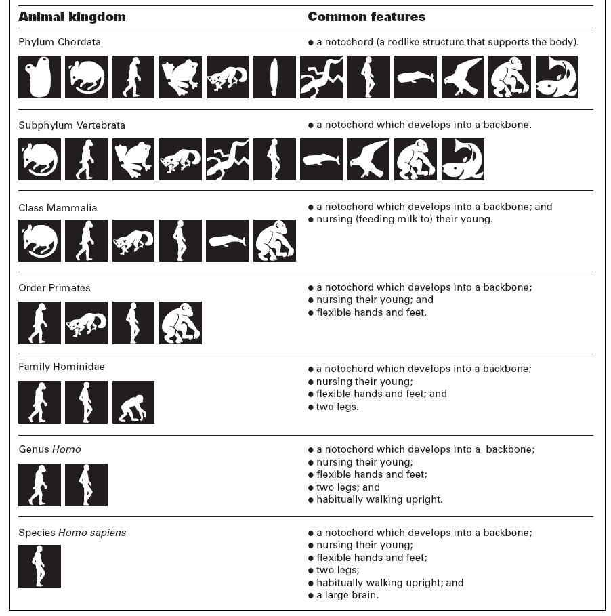
Object Oriented Programming Inheritance, Subtyping, Generalization – contd.

Slide 37
Object Oriented Programming Inheritance/Generalization – Exercises
Which of the below examples correspond to is-a relationship, and which – don't?
Code exercises
Up-casting & down-casting. C++ casts

Slide 38
Object Oriented Programming Composition or Inheritance? Liskov Substitution Principle
"Favor object composition over class inheritance"
This means to avoid code reuse by inheritance (Phone-Display example)
In that case, we inherit only interfaces, thus following true subtyping, and reuse code only via composition/aggregation
Liskov Substitution Principle (LSP)
Subtypes must be able to substitute their supertypes without altering program's correctness
Example with Rectangle and Square, breaking LSP

Slide 39
Object Oriented Programming Multiple Inheritance
Multiple Inheritance (MI) – a scenario where a descendant has more than 1 base classes
The descendant (i.e. Chocolate) inherits base classes' "features"
"is-a" relation to all base classes (i.e. both BuildingMaterial and FoodMaterial)
Ambiguities may occur (i.e. having members with the same name). If that happens, use scope operator to resolve (i.e. Base1::x vs. Base2::x)

Slide 40
Object Oriented Programming Multiple Inheritance – Dangers
Dreaded Diamond
How many copies of density does a Chocolate instance have?
Virtual Inheritance

Slide 41
Object Oriented Programming Interfaces – Revisited
Interface as a separate entity. UML notation
implements (realizes) relationship. Implementation vs. Inheritance
When to extract a separate interface and when to use the class directly
"Service classes" vs. "Data classes"
Some of the classes carry data (i.e. some Coordinates class, or std::string). They might have several simple operations (accessors – getters/setters), but their purpose is to contain and carry relevant information. In simplest case, if no changes expected, it's OK to even expose attributes (i.e. x and y coordinates)
Other classes do some job for us: DBConnector (i.e. to create a connection to a database), ShapeFactory (create an object – instantiate a Shape descendant), etc.

Slide 42
Object Oriented Programming Interface Segregation Principle. Program to Interfaces
Interfaces in this sense (as a language construct, or some substitute such as pure virtual classes) become a unit of reusability
A common mistake is to combine logically separate methods into one interface
Interfaces, similarly to classes, shall obey Single Responsibility Principle
During design phase, split interfaces into small reusable units
This is called segregation
Better err on the side of smaller, than larger interfaces
Exercise: How would you rework the following interface:

Slide 43
Object-Oriented Programming Polymorphism
"I'll send an SOS to the world"
Sting – "Message in a bottle"

Slide 44

Object Oriented Programming Polymorphism – Definition
"Sit down"
Ability to send a message to an object, without knowing its class
But we have to know something… What is it?
Why we want to be unaware of object's exact class?
Polymorphism as basis of almost all modern OOP techniques

Slide 45
Object Oriented Programming Polymorphism – How-to (C++)
In C++, "send a message" within the same program means (usually) calling a method
To call a method polymorphically in C++ the following is necessary:
An instance of some class (i.e. a Rectangle object)
Either a pointer or a reference of some base type (direct or indirect) – i.e. a Shape* pSomeShape or Shape& shape that refer to the concrete object (the Rectangle object)
The method is called via that base-type pointer or reference
The method must be present in the base class and must be virtual

Slide 46
Object Oriented Programming Polymorphism – Example (UML Class Diagram)
Canvas containing graphic figures which are descendants of Shape
Implement the UML diagram (specifically, update() method that draws all graphical figures and everything necessary to call it) by making sure Canvas class doesn't "know about" (depend on) Rectangle, Circle and other Shape descendants

Slide 47
Object Oriented Programming Polymorphism – UML Sequence Diagrams (briefly)
Objects (objName:Class) with lifelines vertically
Messages (usually method calls)
Closer to the implementation – sequence of method calls along the lifeline
Notes:
Examples in C++

Slide 48
Object-Oriented Programming Abstractions
Abstraction in concrete terms

Slide 49
Object Oriented Programming What is "Abstraction"?
Focus on some aspects of a system (concepts; "important stuff") while safely ignoring others ("details")
This is related to characteristics of human mind, the way we think
In OOP world, both interfaces and abstract classes are called "abstractions"
Abstractions are supposed to be designed carefully and be more stable than details. They are more dependable.
Rule: Depend on abstractions, not on concrete classes

Slide 50
Object-Oriented Programming Genericity (Templates)
Brief intro

Slide 51
Object Oriented Programming Templates – Intro
What if there is the same algorithm for processing several different types of data? Code manually several different functions?
void myswap(int& x, int& y) {
int temp = x;
x = y;
y = temp;
}
void myswap(double& x, double& y) {
double temp = x;
x = y;
y = temp;
}
We need to avoid code duplication (one of “code smells” – a sign for poor quality)
Therefore we’d like to write the function code once replacing some of the specific type(s) with parameters (i.e. instead of int or double write T)
Provide T “argument” where the template is used, somewhat similar to function arguments
This is yet another way to achieve better reusability and maintainability

Slide 52
Object Oriented Programming Function Templates
#include <iostream>
template <typename T> // template <class T> is the same, but class would be a little misleading here
void myswap(T& x, T& y) {
T temp = x;
x = y;
y = temp;
}
int main() {
int x = 5, y = 6;
double z = 8.7, t = 1.2;
int p = 18, q = 3;
myswap<int>(x, y); // Pass int as template argument. The compiler generates a function myswap(int&, int&) for you!
myswap<double>(z, t); // Pass double as template argument. The compiler generates myswap(double&, double&)!
myswap(p, q); // The compiler deduces the template argument (here int). Thus myswap(int&, int&) is used.
std::cout << x << ", " << y << std:: endl;
std:: cout << z << ", " << t << std::endl;
std:: cout << p << ", " << q << std::endl;
return 0;
}

Slide 53
Object Oriented Programming Class Templates
// In a header file (i.e. MyPair.hpp)
template <typename T> // Again, template <class T> works the same
class MyPair {
public:
MyPair(const T& first, const T& second)
: m_first(first), m_second(second) {}
T& max(); // Can be defined outside the class...
private:
T m_first;
T m_second;
};
// Definition of a method outside the template class, but still in the header (MyPair.hpp)!
template<typename T>
T& MyPair<T>::max() {
return m_first > m_second ? m_first : m_second;
}

Slide 54
Object Oriented Programming Class Templates – contd.
// How to use the template class MyPair - i.e. in main.cpp
#include <iostream>
#include "MyPair.hpp"
int main() {
MyPair<int> intPair(5, 3); // The compiler generates a class MyPair<int> for you!
MyPair<double> doublePair(5.4, 11.9); // The compiler generates a class MyPair<double> for you!
MyPair<char> charPair('q', 'a'); // The compiler generates a class MyPair<char> for you!
std::cout << intPair.max() << std::endl;
std::cout << doublePair.max() << std::endl;
std::cout << charPair.max() << std::endl;
return 0;
}

Slide 55
Object Oriented Programming C++ fundamentals. Exceptions
Error handling. Compare strategies:
Return codes
Exceptions
More on exceptions

